Slide 1

USA PERFORMANCE℠
Manage Performance, Ensure Success
OPM’s Performance Management System for Federal Agencies
USA Performance Training for Administrators – Day 3
[insert Agency Name]
[insert date]
OFFICIAL USE NOTICE: This material is intended exclusively for use by USA Performance Customers and is not to be distributed without approval from the USA Performance Program Office. This communication may contain information that is proprietary, privileged, confidential or otherwise legally exempt from disclosure. If you have received this presentation in error, please notify the USA Performance Program Office immediately and delete all copies of the material.

Slide 2
Today’s Agenda
Day 1-2 Review
Using the Performance Element Library
Performance Plan Templates
Hands-On Exercise
Check on Learning

Slide 3
Performance Element Library

Slide 4
Create a Performance Element in the Performance Element Library

Slide 5
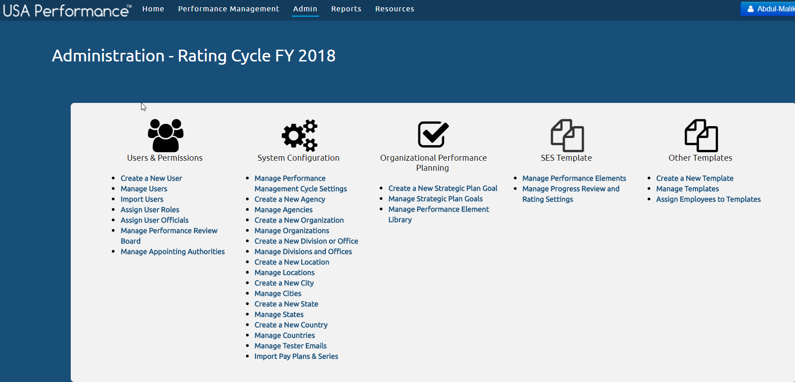
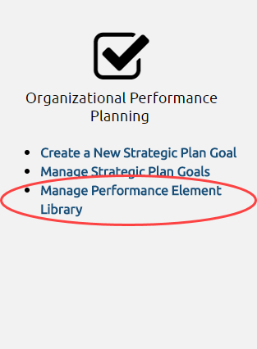
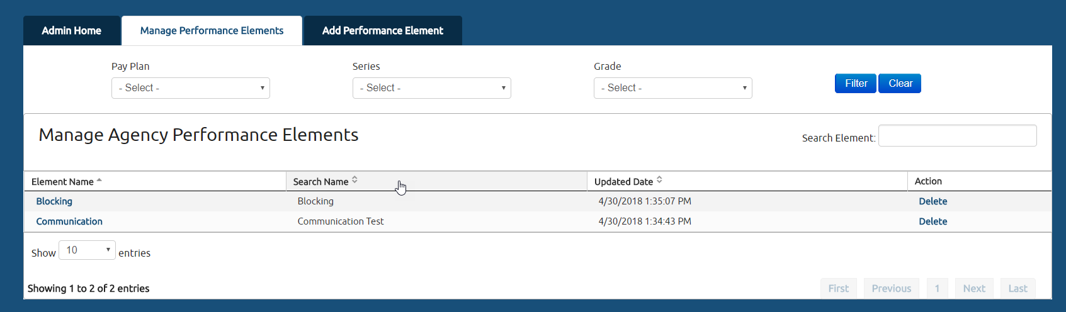
Adding Elements to the Library
Elements can only be added to the Performance Element Library through the “Manage Performance Element Library” page

Slide 6
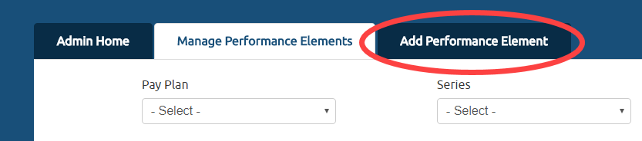
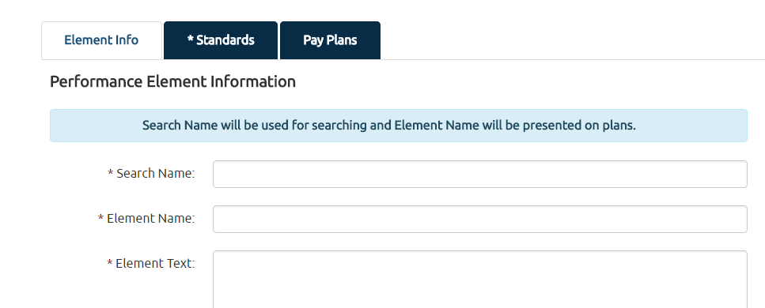
Adding Performance Elements
Checklist:
Element Information (required)
Add all general element information
Standards (required)
Create and apply new or existing customized performance standards
Pay Plans (optional)
Add pay plan information

Slide 7
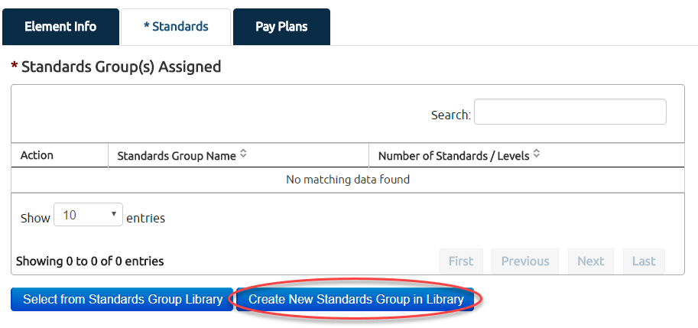
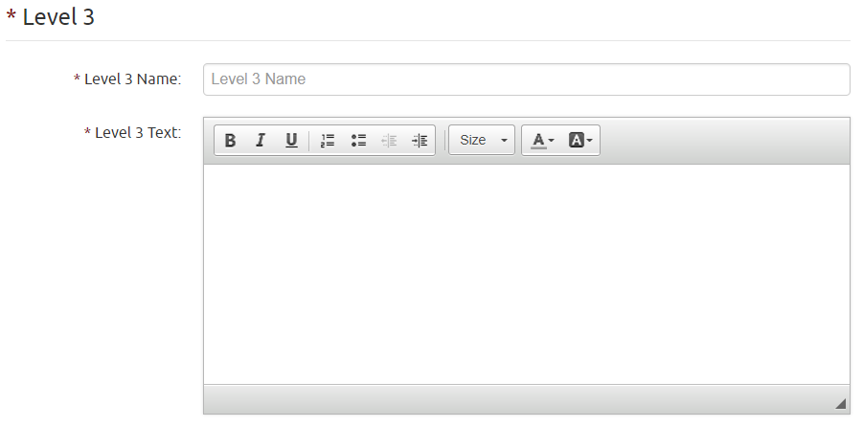
Adding Performance Standards
Two Options:
1) Select existing Standards Group
2) Create new Standards Group
Choose which levels you want included in the plan

Slide 8
Demo System

Slide 9

Time to Test the System!
Log onto the Test Site
Turn to page [ ] of your workbook

Slide 10
Edit a Performance Element in the Performance Element Library

Slide 11
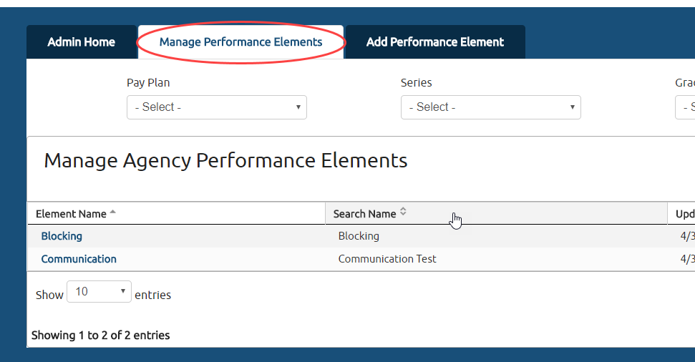
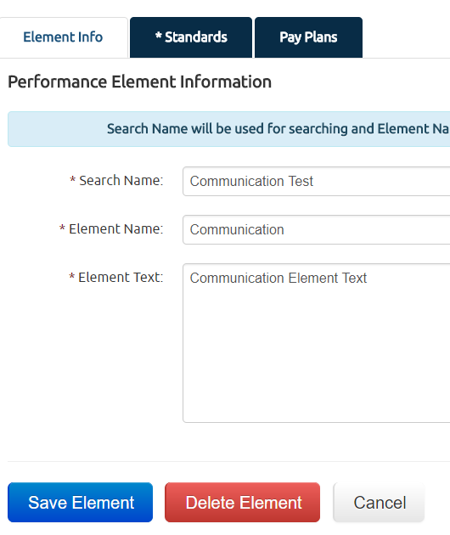

Editing Elements in the Library

Slide 12
Demo System

Slide 13
Time to Test the System!
Log onto the Test Site
Turn to page [ ] of your workbook

Slide 14
Performance Plan Templates

Slide 15
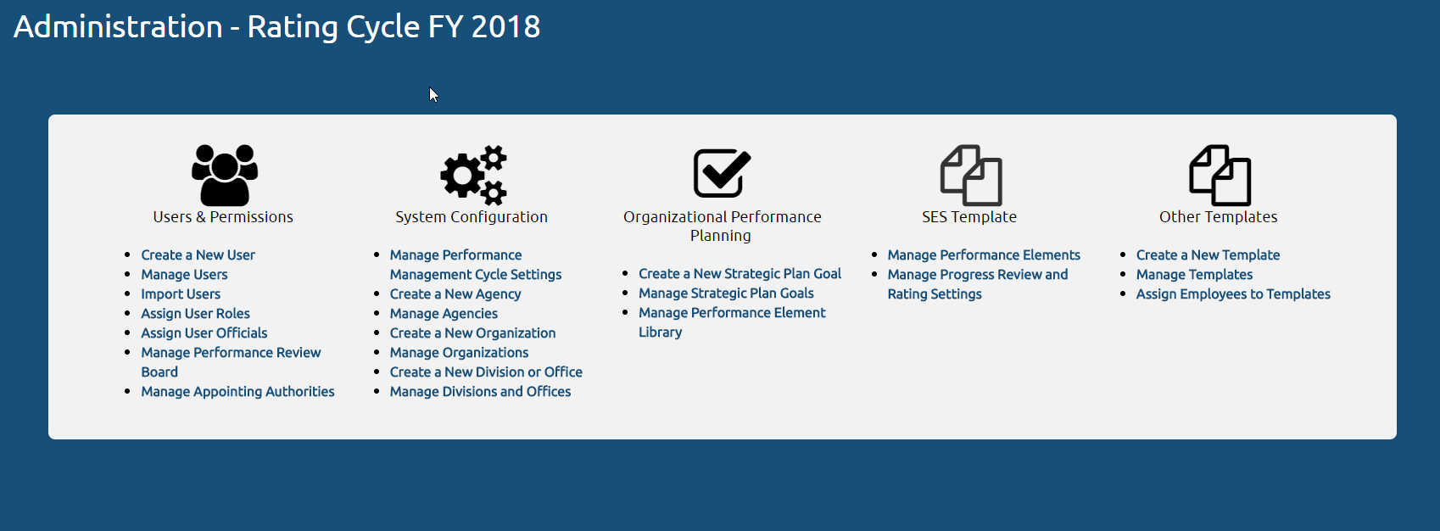
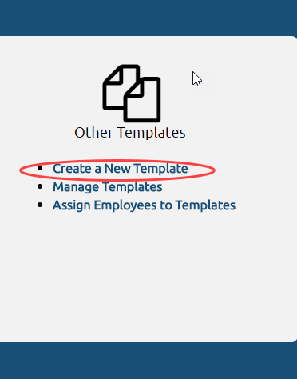
Template Wizard Overview
The Template Wizard is a tool that allows Agency Administrators to create performance plans for all non-SES pay plans. Organizational and Division Administrators can assign employees to templates.

Slide 16
Create a Performance Plan Template

Slide 17
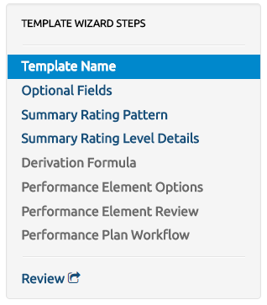
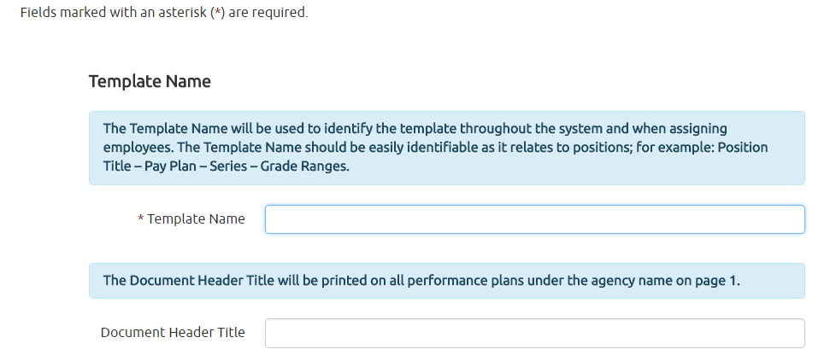
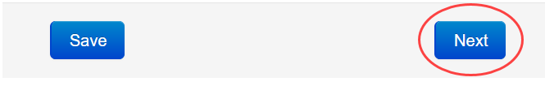
Template Wizard Step 1: Naming the Template

Slide 18
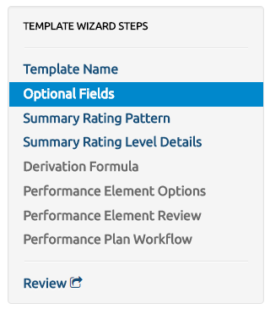
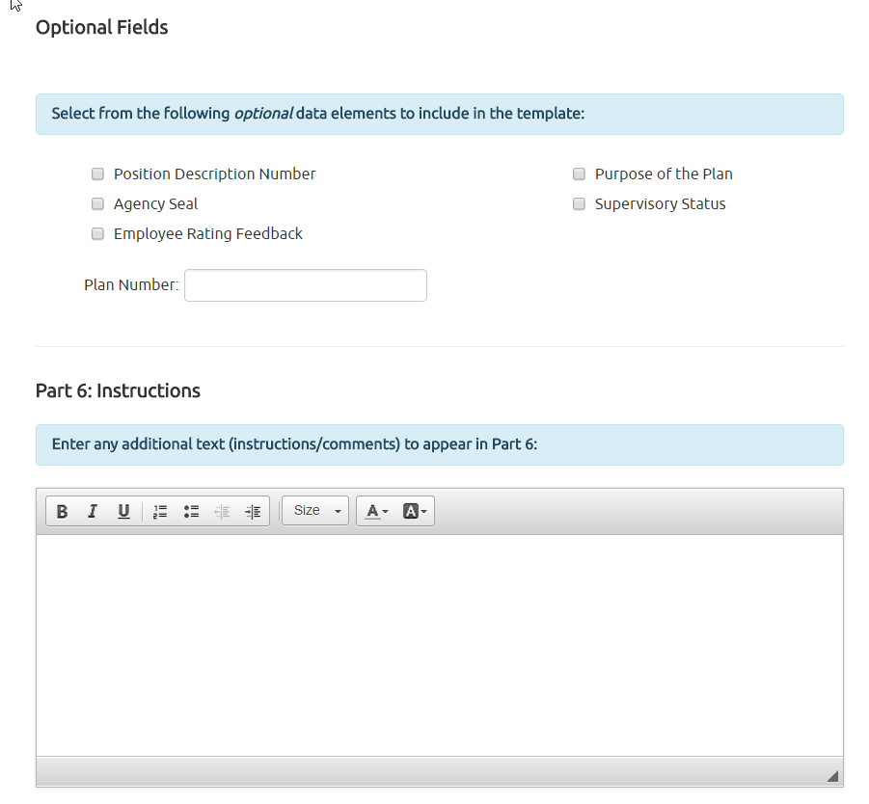

Template Wizard Step 2: Add Optional Fields

Slide 19
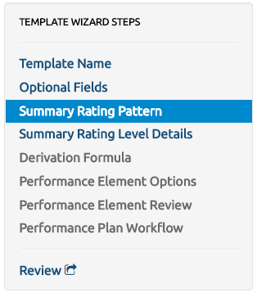
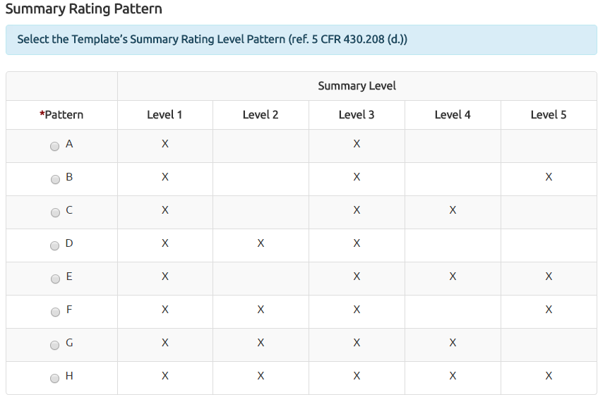
Template Wizard Step 3: Choose a Rating Pattern

Slide 20
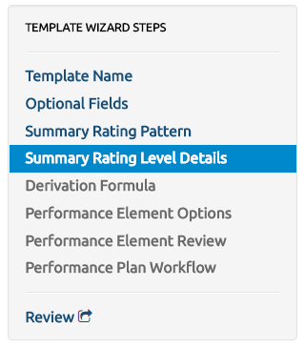
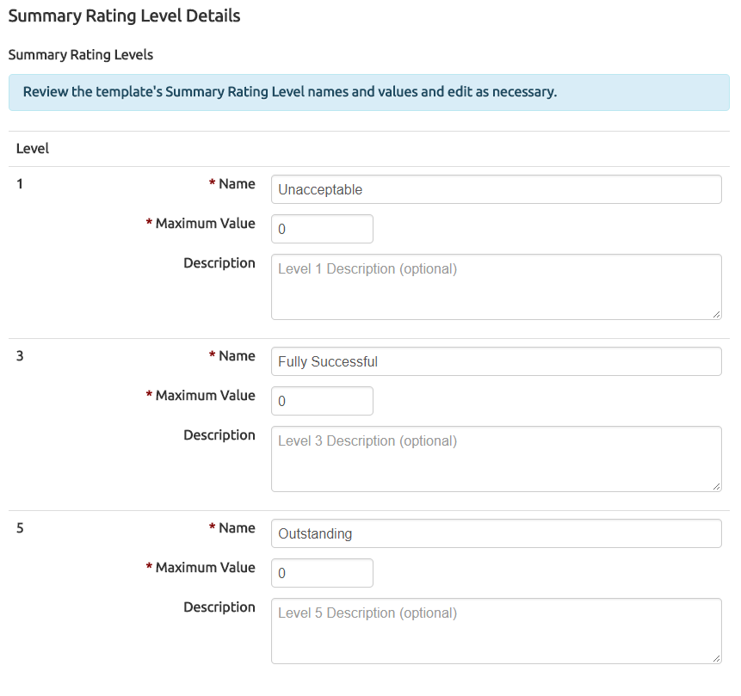
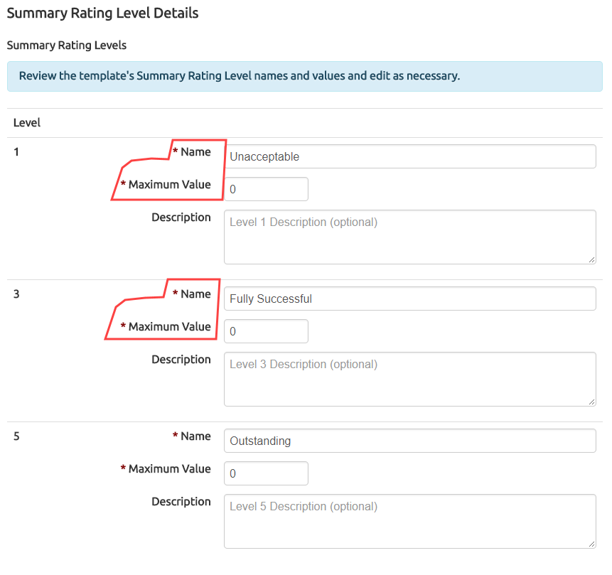
Template Wizard Step 4: Adding Rating Level Details

Slide 21
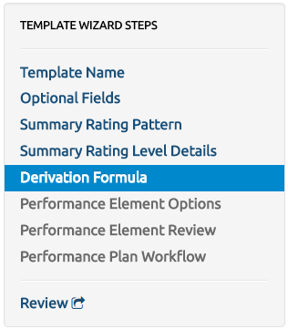
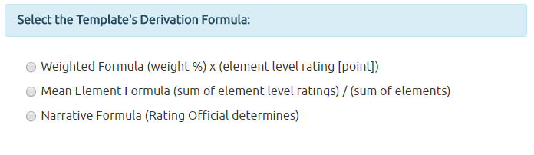

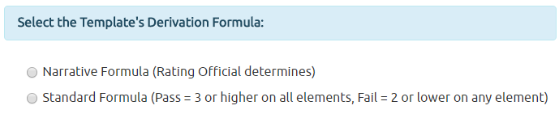
Template Wizard Step 5: Choose a Derivation Formula

Slide 22
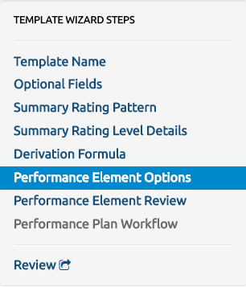
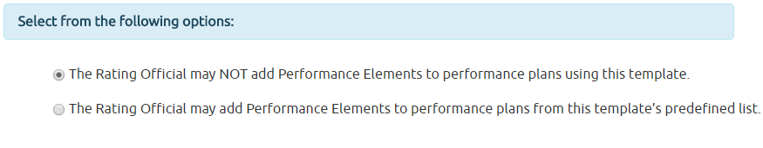
Template Wizard Step 6: Rating Official Options

Slide 23
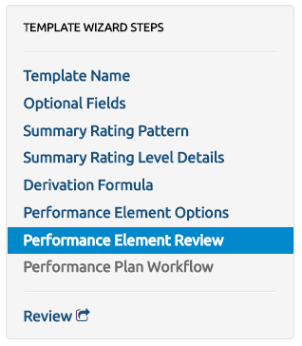
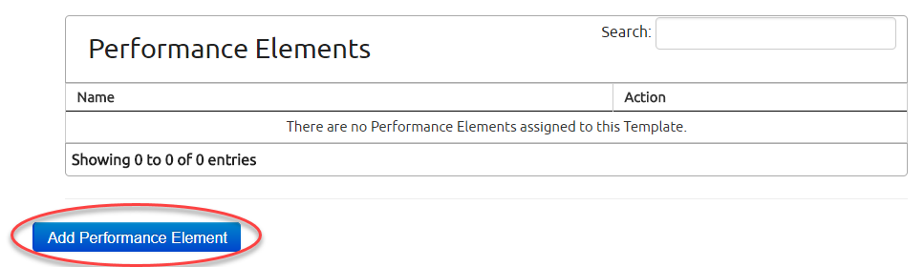
Template Wizard Step 7: Performance Element Review

Slide 24
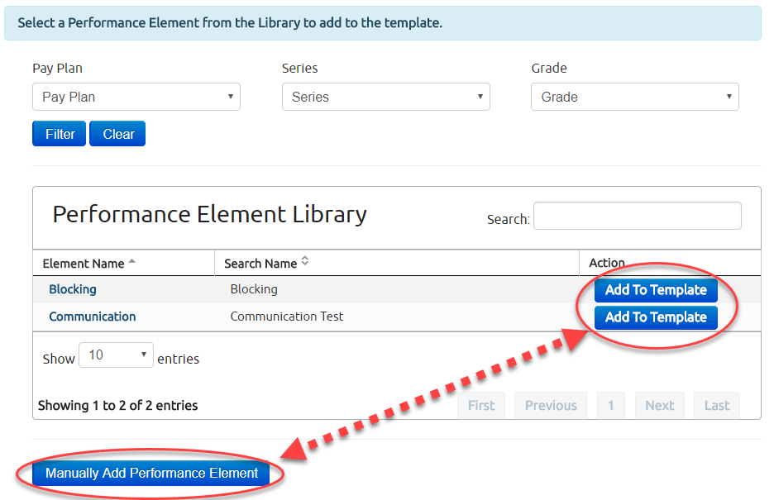
Template Wizard Step 7.1: Performance Element Review
Two Options
Manually Add a Performance Elements
One-off option for irregular elements
Add from Performance Element Library

Slide 25
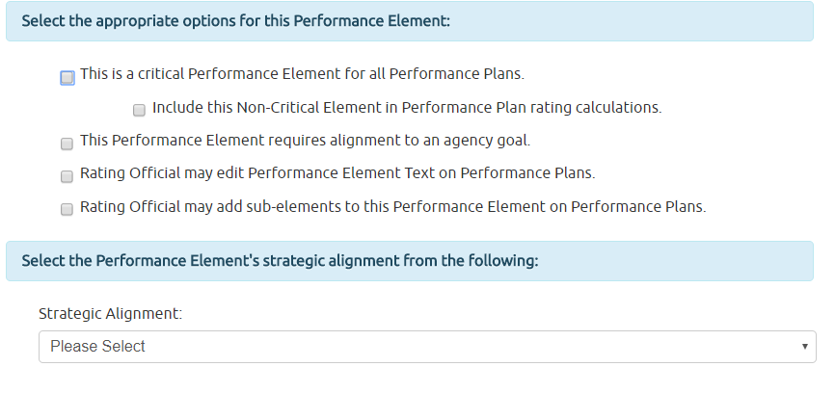
Template Wizard Step 7.2: Select Element & Options

Slide 26
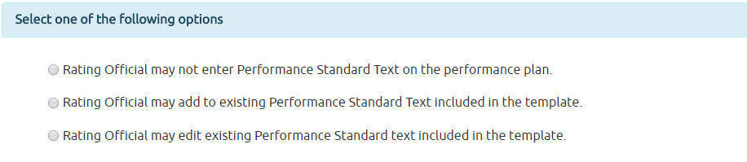
Template Wizard Step 7.3: Setting Rating Official Edit Permissions

Slide 27
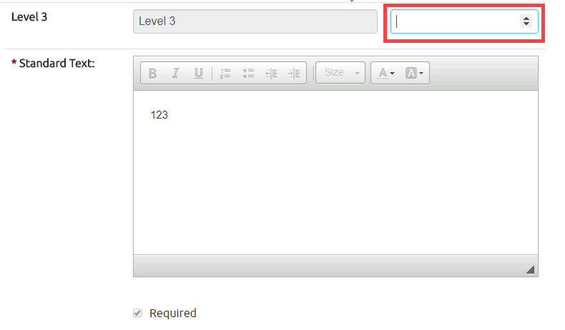
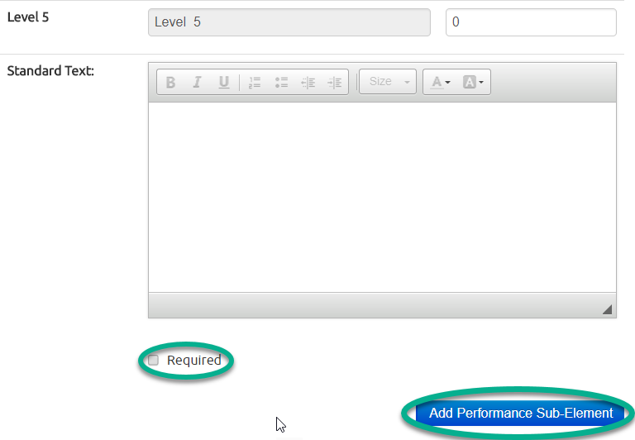
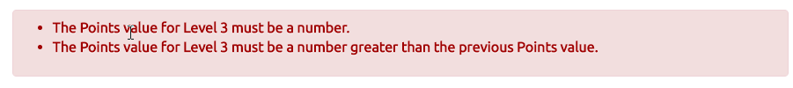
Template Wizard Step 7.4: Set Points, Requirements, Sub-Elements

Slide 28
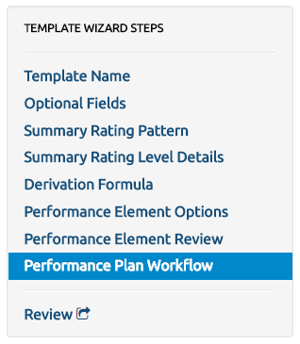
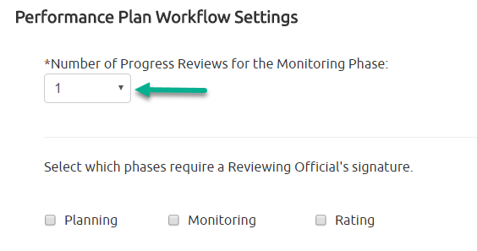
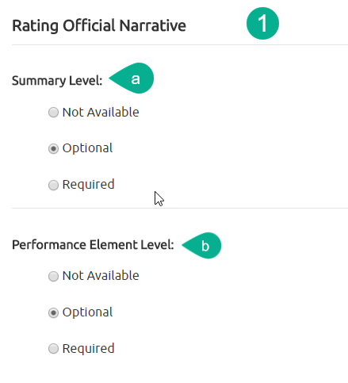
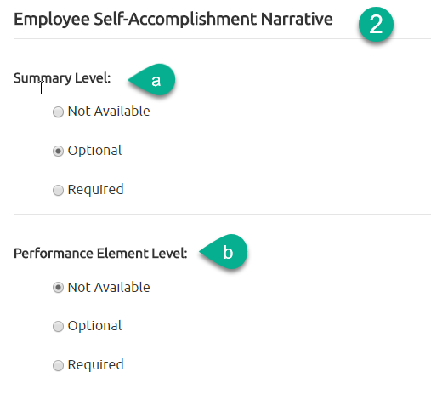

Template Wizard Step 7.5: Set Workflow & Narratives

Slide 29
Demo the System

Slide 30
Time to Test the System!
Turn to page [] of your workbook

Slide 31
Assign Templates

Slide 32
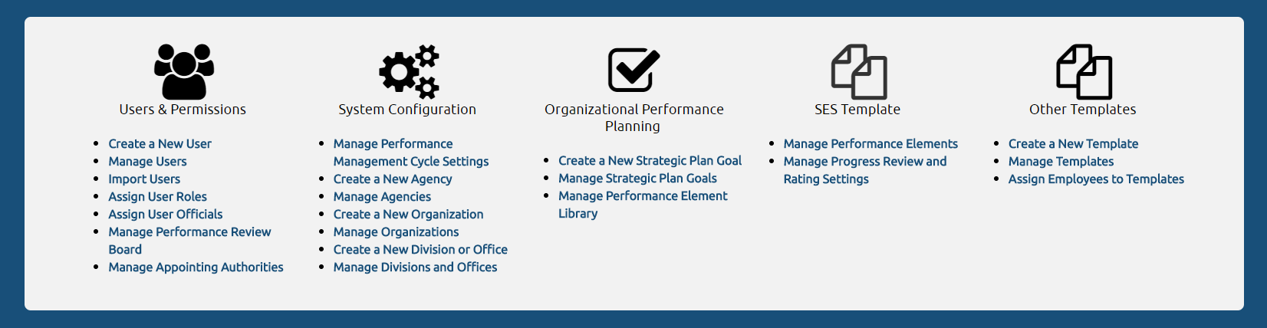
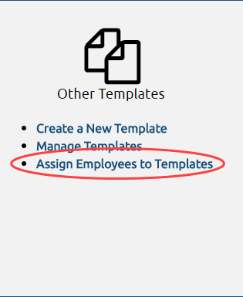
Assign Templates
The Template Wizard is a tool that allows Agency Administrators to create performance plans for all non-SES pay plans. Organizational and Division Administrators can assign employees to templates.

Slide 33
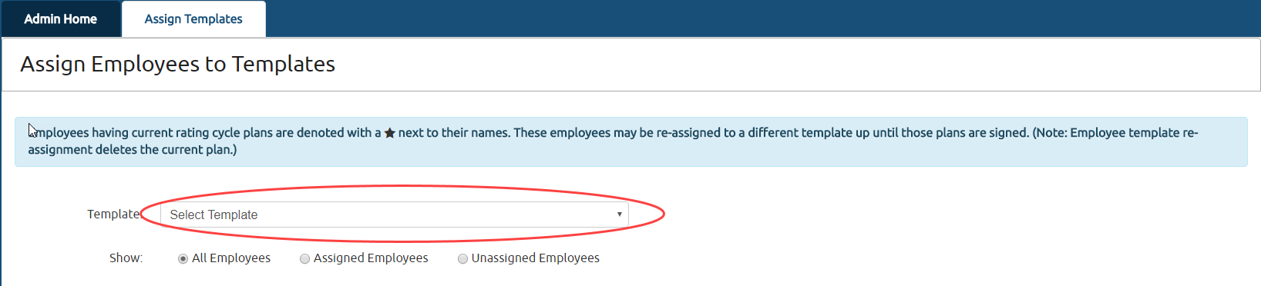
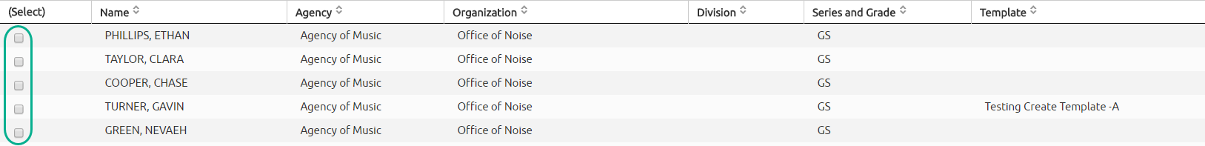

Assign Templates: Assign One or More Users

Slide 34
Demo the System

Slide 35
Time to Test the System!
Turn to page [] of your workbook

Slide 36
Manage Templates

Slide 37
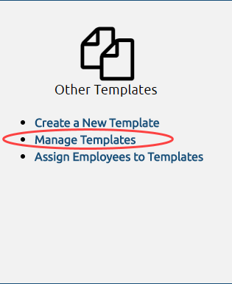
Manage Templates
Allows You to:
Edit Existing Templates
Delete Templates
Add Templates

Slide 38
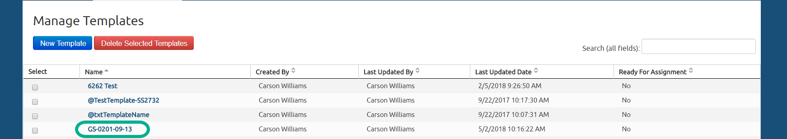
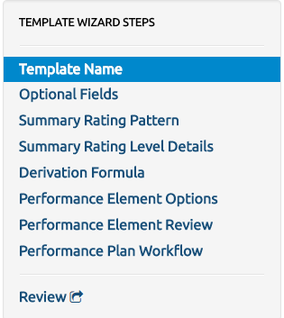
Manage Templates: Editing
Once selected, you can make adjustments to any existing field. To finalize, or make the template assignable, press “Finish”

Slide 39
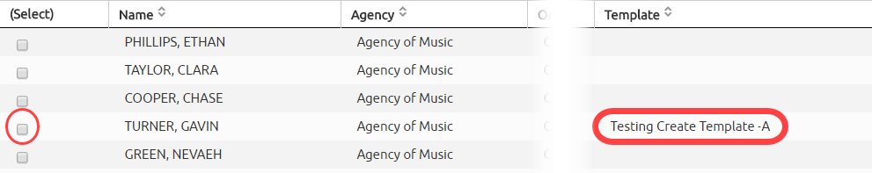
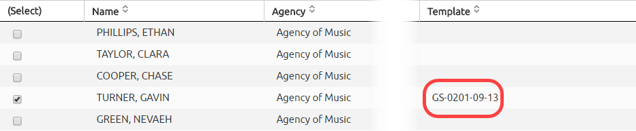
Manage Templates: Reassign Templates
Reassign an Edited Template Steps:
Select a Template other than the Edited Template
Check the User You Want Reassigned
Save
Select the Edited Template
Assign it to the User and Save

Slide 40
Demo the System

Slide 41
Time to Test the System!
Turn to page [] of your workbook

Slide 42
Copy Templates

Slide 43
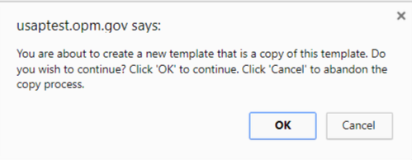

Copy Templates
Any existing finalized template can be copied. Simply select a template, then select the Copy Template button in the upper right hand corner.

Slide 44
Demo the System

Slide 45
Time to Test the System!
Turn to page [] of your workbook

Slide 46
Hands-On Exercise

Slide 47
Demo the System

Slide 48
Time to Test the System!
Turn to page [] of your workbook

Slide 49

Check on Learning!
Turn to page [INSERT PAGE #] of your workbook

Slide 50
For More Information, Contact:
[insert account manager name]
Account Manager, USA Performance
[insert email]
[insert phone number]

